Slide 1
(De)constructing Health News An analysis of the lifecycle of elderly-related health news stories through multi-sited, linguistic ethnographic research
Jana Declercq
Health, Media & Society
13/11/2014
Notes:
We are the research group Health, Media & Society, based on a collaboration between different faculties at Ghent University. Our main research goal is focused on the four-year research project “Deconstructing health news”.

Slide 2
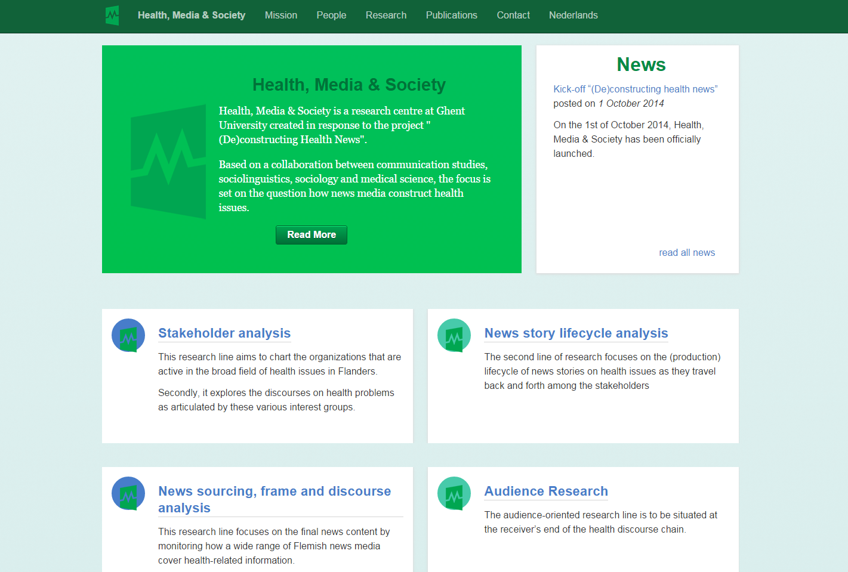
Health, media & society

Slide 3
Health, Media & Society
A transdisciplinary investigation:
Communication studies
Journalism studies
Linguistics
Sociology
Medicine

Slide 4
(De)Constructing health news
Team:
6 Supervisors
1 postdoc researcher
4 PhD researchers
Fund: Special Research Fund from Ghent University
Time: 4 years: 2014-2018

Slide 5
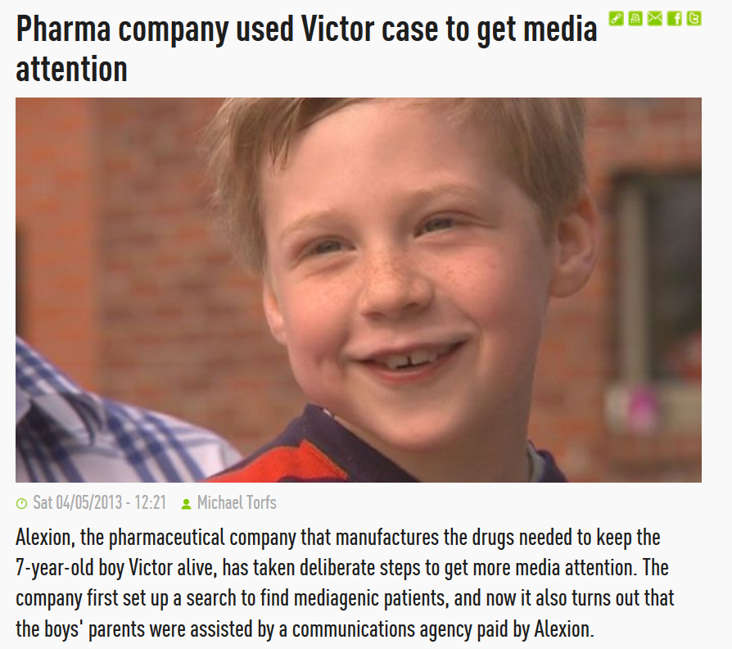
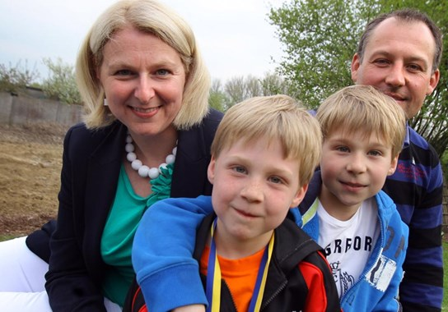
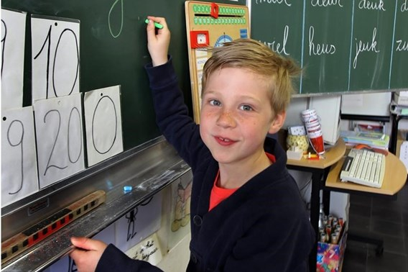
Meet Viktor
Notes:
Not related to the elderly population, but very controversial case in Belgium. Example of how the interests of seemingly contradictory stakeholders (pharma and patients) can sometimes be aligned. Controversial in this case is the way in which the pharmaceutical company selected a mediagenic patient to attract more coverage and put pressure on the government to refund their drugs and thereby increase sales and profits.

Slide 6
Meet Viktor
aHUS
Soliris: € 18 000/month (Alexion)
No reimbursement
Over 36 000 signatures
Notes:
Not related to the elderly population, but very controversial case in Belgium. Example of how the interests of seemingly contradictory stakeholders (pharma and patients) can sometimes be aligned. Controversial in this case is the way in which the pharmaceutical company selected a mediagenic patient to attract more coverage and put pressure on the government to refund their drugs and thereby increase sales and profits.

Slide 7
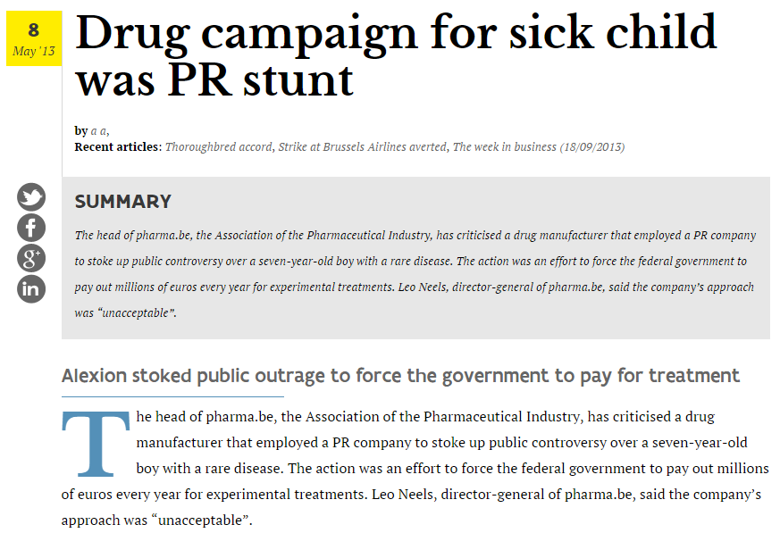
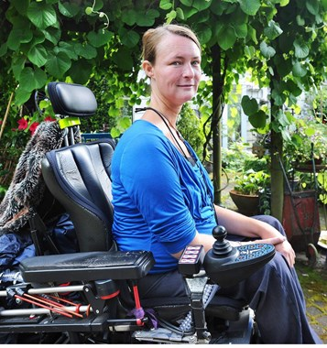
Viktor

Slide 8
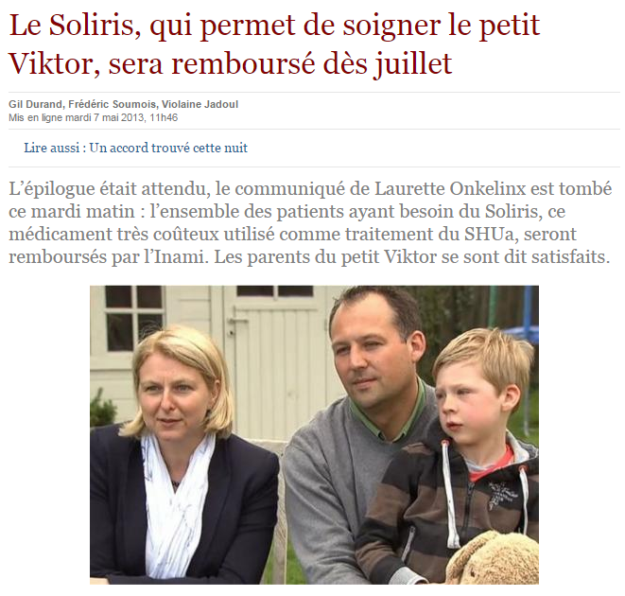
vIKTOR

Slide 9
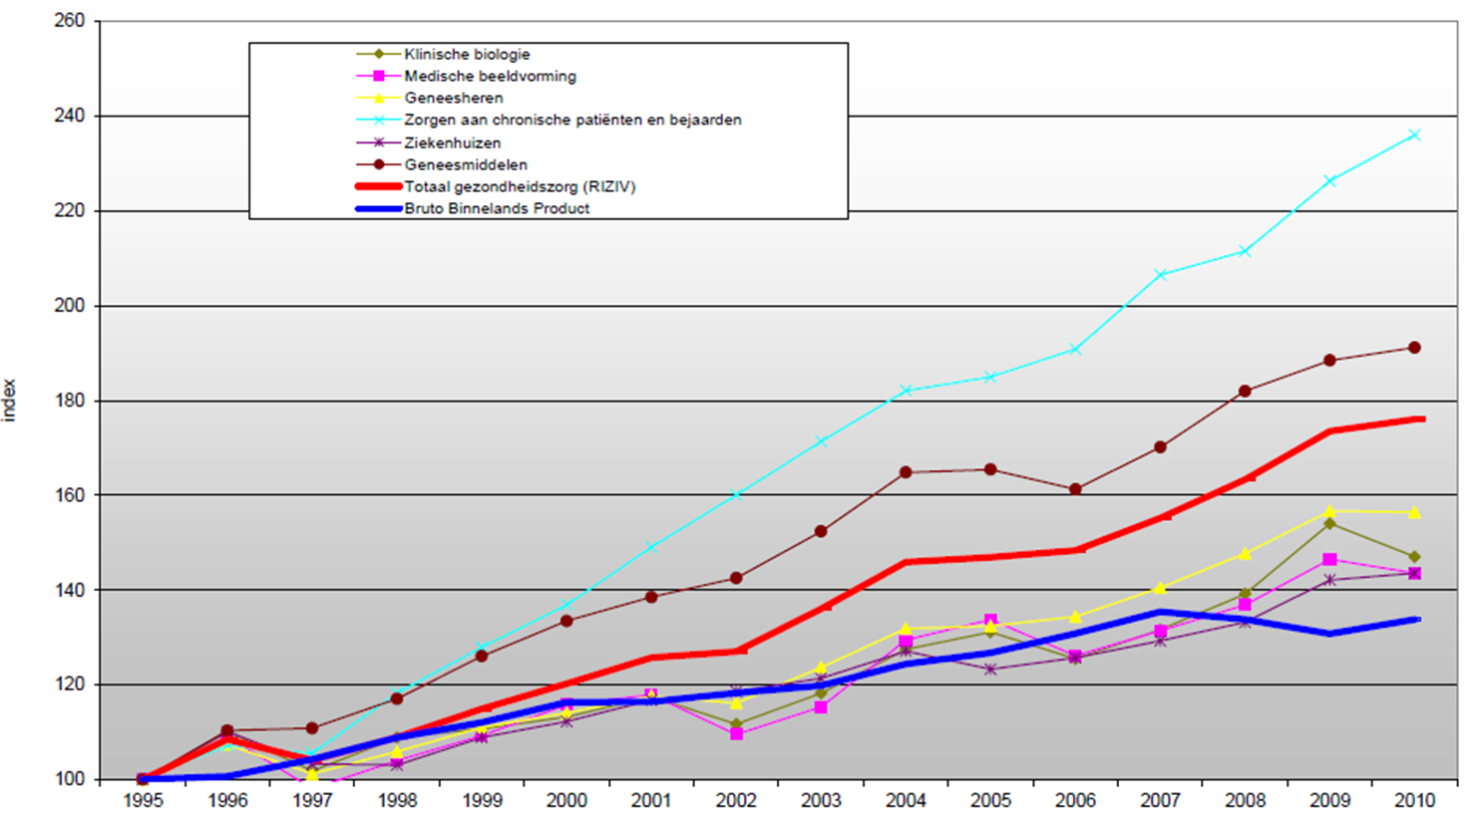
Costs health care system in Belgium
1995 2000 2005 2010
Notes:
Where does our focus on health news come from?
If we look at this stat, we can see that the total cost of our health care system is increasing at a hogher rate than our gross national product, which raises concerns about the affordability of our health care system. This major increase of health care costs is related to different shifts, such as better treatments and also the ageing of the population. This is why we focus especially on the construction and deconstruction of elderly-related health issues.

Slide 10
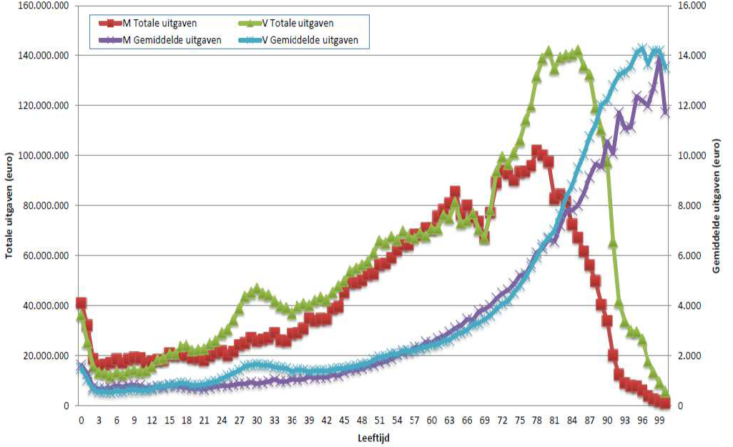
Elderly as a target group
60
Expenditure
Age
Notes:
Our focus is on the elderly, who constitute an increasingly important player in the context of health news and communication. Current demographic projections expect that in 2015 19% and in 2030 25% of the Belgian population will be over 65. Health issues are very important to the elderly: they consume more than 40% of all prescribed drugs (RIZIV) and concerns about the future make them very sensitive to health-related news.

Slide 11
Societal evolutions
Medicalization
Healthism
Notes:
Medicalization = the processes by which social phenomena come to be perceived and treated as illnesses” such as deviant behaviours, mourning, …
Healthism = increased attention for healthy lifestyles as normative behavior
Debate = Both perspectives agree that medicalization has raised health literacy and has contributed to a more active patient involvement. The difference lies in the fact that the first perspective tends to overestimate, while the second tends to underestimate the shared interests of citizens and the health industry.

Slide 12





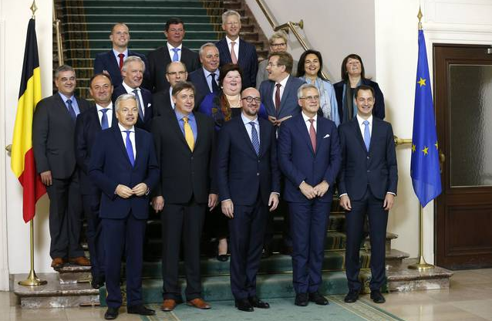
Stakeholders
Notes:
What distinguishes this project from previous efforts in this area is that we propose a holistic approach in which we extend our investigation beyond the newsroom towards 'the peripheries' of the news industry. The following nine stakeholder categories will be looked at.
We will analyze the relations between these stakeholders and the discourses that they produce and how they try to influence news coverage.

Slide 13
Black box
Stakeholder 1
Stakeholder 2
Stakeholder 3
Stakeholder 4
Stakeholder…
Elderly
Notes:
Up till now most academic work on health in the news has variously focused on the text - the media message -, OR on its producers
OR on its recipients, hence dividing the complex network of bottom-up and top-down processes in different unrelated spheres of interest and study, and not observing it in its totality. Therefore, until now we don not have a complete insight in the process of information exchange between different stakeholders and the audience.

Slide 14
Research design
RL1
STAKEHOLDER
ANALYSIS
RL2
NEWS STORY LIFECYCLE ANALYSIS
RL3 NEWS SOURCES, FRAME AND DISCOURSE ANALYSIS
RL4
NEWS MEDIA UPTAKE ANALYSIS AND AUDIENCE RESEARCH

Slide 15
Analysis of health news production process
Method:
Multi-sited, case-oriented, linguistic ethnography
Sites:
Newsrooms
PR-offices
Weblogs
Investigative journalism vs. reproduction of PR-stories and press releases?
Notes:
I aim to examine the lifecycle of news stories on elderly-related issues. I will map the complex discursive processes and professional routines that shape press releases and newspaper articles. Is news that is initiated by corporate Public Relations offices simply reproduced more or less verbatim in the media, or do journalists make critical inquiries into the issues discussed and recontextualise what they have read in the PR-messages and press releases? Do the stakeholders actually do what they claim to do in WP1? Put simply, I will scrutinize not what is written, but how it is written. Why does a journalist or PR-officer construct his or her story this or that way? And what factors influence the journalists’ or PR-officer’s choices in the construction of a news story?

Slide 16
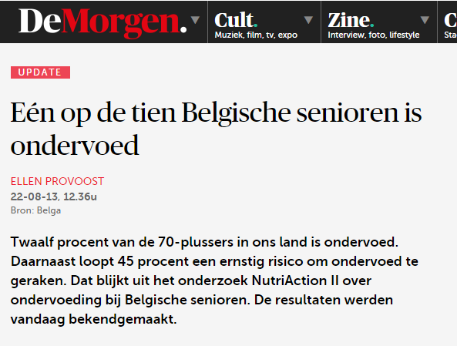
Case study ii: Nutricia
“One out of ten Belgian elderly suffers from under-nutrition”
NutriAction II
Description of research, methods and results
Quote minister of Wellbeing
Initiator: Advanced Medical Nutrition
Source: Belga → biggest national press agency

Slide 17
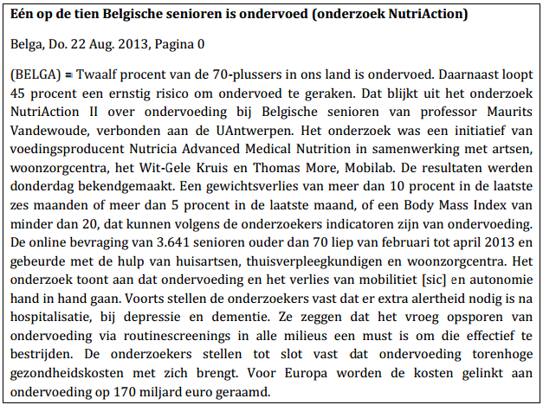
Nutricia
“One out of ten Belgian elderly suffers from under-nutrition (NutriAction research)”

Slide 18
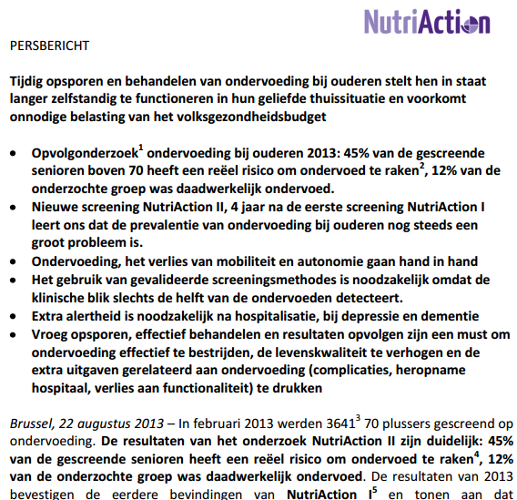
Nutricia

Slide 19
Press releases
Stryker (Preventive Medicine, 2002):
80%-88% of news stories about journal articles with enclosed PRs
A journal article with a PR enclosed →26.6 media stories
A journal article without a PR → 5.94 media stories
Yavchitz et al. (PloS Medicine, 2012):
“Press releases are a major source for one-third of medical reports in US newspapers” (2)

Slide 20
Yavchitz et al. (2012)
Examples of ‘spin’:
Inappropriate extrapolation
Focus on positive secondary outcome

Slide 21
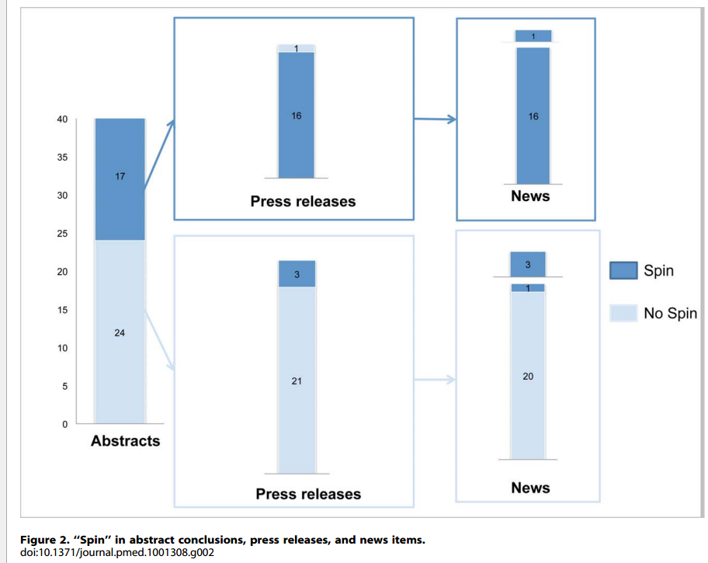
Press releases

Slide 22
Medical journalism
“All this information not only influences awareness, attitudes, and intentions but may also contribute to changes in behavior, health care utilization, clinical practices, and health policies.” (Levi 2001: 4)

Slide 23
Important issues
Health literacy
Of the PR-writers
Of the journalists
Of the public
Mutual and individual interests of the stakeholders

Slide 24
RL2: Factors in the Newsroom
Practical issues:
Deadlines, time constraints
Accessibility of sources
Role of the editor-in-chief
Journalistic norms and roles
News value
Use of exemplars/human angle

Slide 25
Weblogs
?

Slide 26
Discussion
Which other elements can I expect to be of importance in my fieldwork? To what should I pay extra attention?

Slide 27
Discussion
Pitfalls?

Slide 28
Discussion
Negative tone?

Slide 29
More information
www.healthmediasociety.net

Slide 30
Bibliography
Levi, Ragnar (2001). Medical Journalism: Exposing Fact, Fiction, Fraud. Iowa State University Press: Ames
Stryker, Jo Ellen (2002). “Reporting Medical Information: Effects of Press Releases and Newsworthiness on Medical Journal Articles’ Visibility in the News Media.” Preventive Medicine 35 (519-530)
Yavchitz, Amélie; Isabelle Boutron; Aida Bafeta; Ibrahim Marroun; Pierre Charles; Jean Mantz; Phillipe Ravaud (2012). “Misrepresentation of Randomized Controlled Trials in Press Releases and News Coverage: A Cohort Study.” PLOS Medicine 9:9 (1-11)

